Slide 1
Subsidies per unit energy delivered
It’s Time to Stop Whining
ICCC-9, 7-9 July 2014

Slide 2
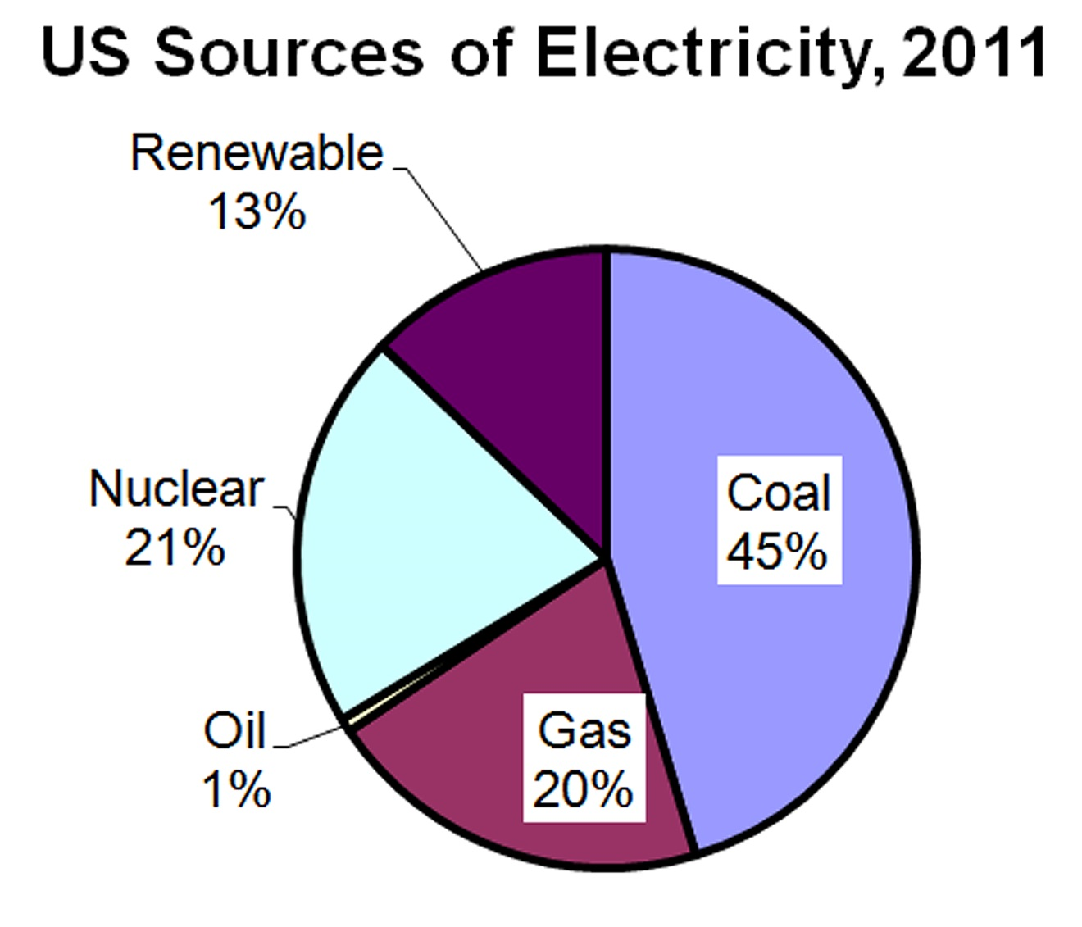
US Electricity
Apparently a big deal!
Overall: 40% of
US Energy is used
to produce electricity

Slide 3
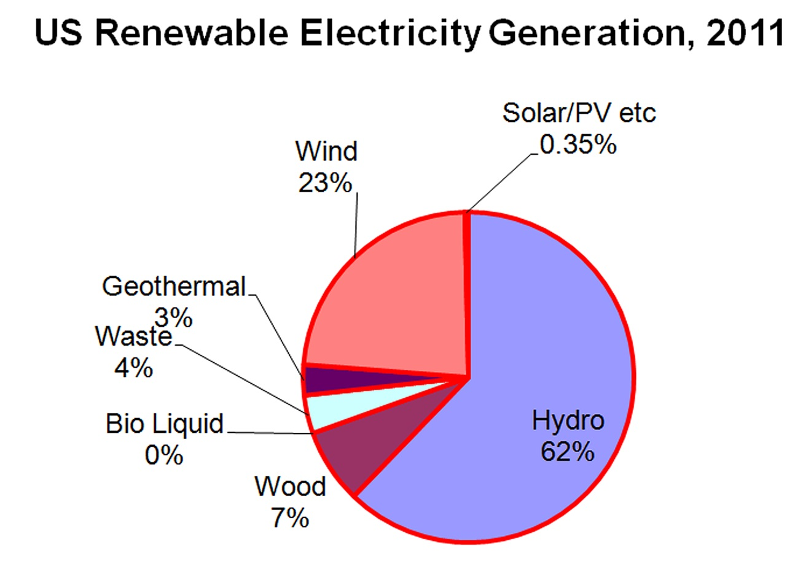
Wind and What?
Overall: 13% of
US Electricity
¾ of our renewable electricity is old-hat stuff: hydro and biomass

Slide 4
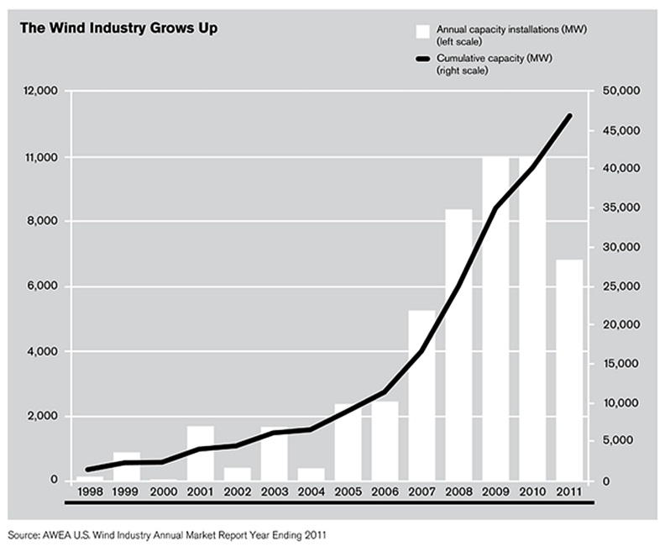
The Fledgling Wind Industry
12
48 Billion Nameplate Watts !!
Pobrecito!
50
10
40
8
30
GW (Nameplate) Added per year
Cumulative GW (Nameplate)
6
20
4
2
10

Slide 5
Wind is the “Biggie”
Nameplate “capacity” = 48 GW, equivalent to about 40 nukes.
Or would be, if they ran 90% of the time instead of 35%
Nevertheless, not a single conventional power plant anywhere has been mothballed or closed because of available wind power.

Slide 6
Wind Subsidies by Whatever Name
MANDATES !!
There are only two forces in the marketplace: Competition and its Enforced Absence
Double-Declining balance accelerated depreciation (5-yr.; 200% depreciation)
cf. 20-year depreciation for conventional power plants
Investment tax credit
Production tax credit

Slide 7
Wind Subsidies by Whatever Name
Back-up energy provided by conventional plants
(Due to diminished efficiency while operating in start-stop mode.)
Transmission lines to nowhere
Long-line Losses
Local tax relief

Slide 8
Wind Energy Production
Highly variable on all time scales
Problems with grid stability
Annual Capacity Factor ≈ 35%
Year-round average power per unit area of land ≈ 12 kW/ha (5 kW/acre) in VERY GOOD SITES

Slide 9
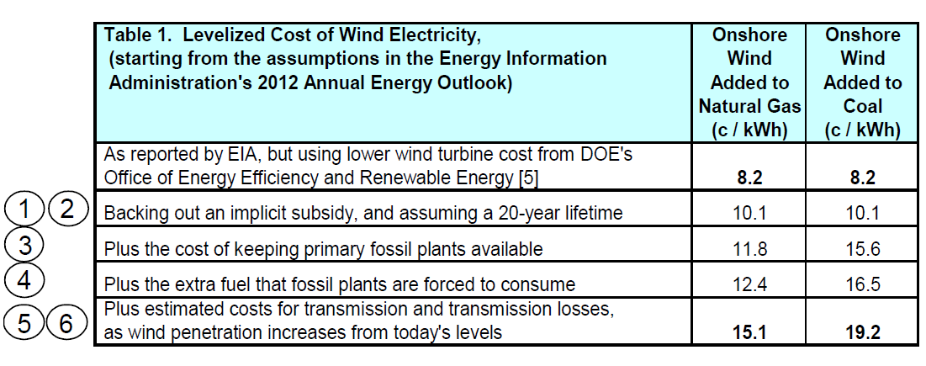
Taylor & Tanton: Wind Costs
George Taylor, Ph.D. and Thomas Tanton The Hidden Costs of Wind Electricity: Why the full cost of wind generation is unlikely to match the cost of natural gas, coal or nuclear generation. Am. Tradition Inst. 31 refs to “official” publications

Slide 10
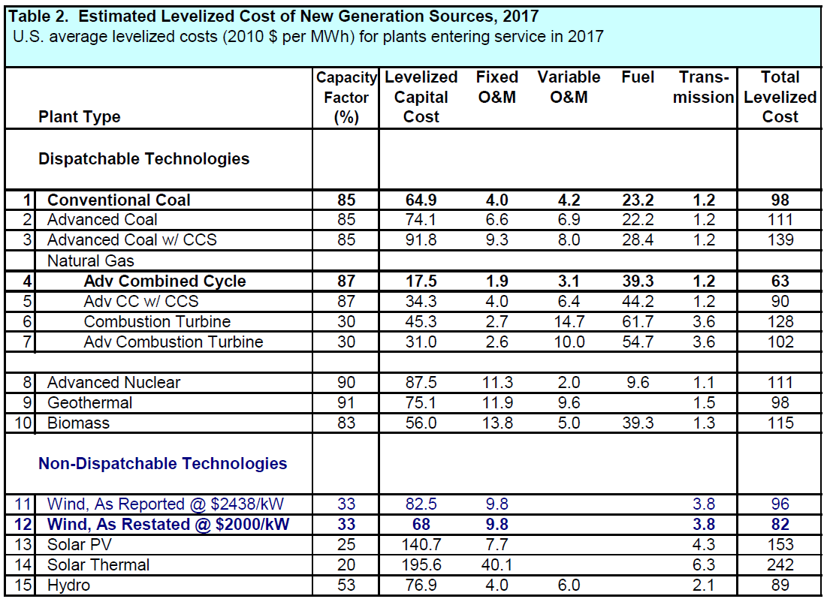
As reported by EIA (2017 proj.)
Divide by 10 to get cents/kWh

Slide 11
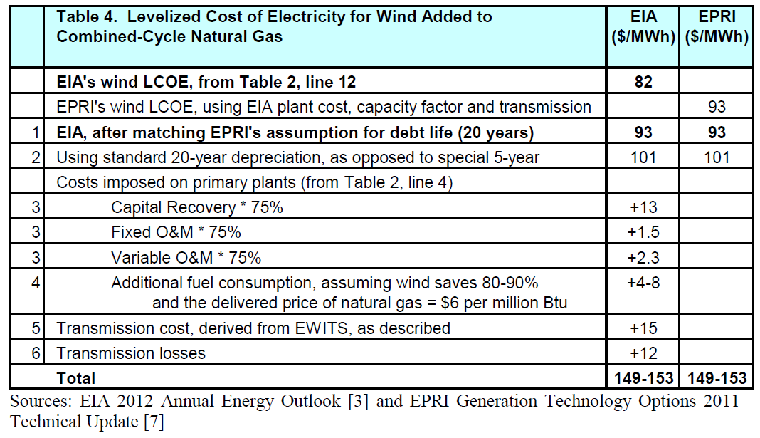
Taylor & Tanton Add in Hidden Costs

Slide 12
Pathetic Biofuel Production
Very poor use of land!

Slide 13
Biofuel Productivity
The best crops (well watered, well fertilized) produce about 10 tons of drymatter per acre per year.
Equivalent to year-round average power of 12 kW/ha (5 kW/acre)
Same as wind, but using all of the land
Refers to heat available if crop is air-dried and burned
Chemical and Engineering News "Chasing Cheap Feedstocks" (C&EN, Aug. 12, page 11)

Slide 14
Biofuel Production - II
If ALL of the arable land in the US were devoted to biofuels, it could not produce the energy we use.
Subsidies or not!
Case closed

Slide 15
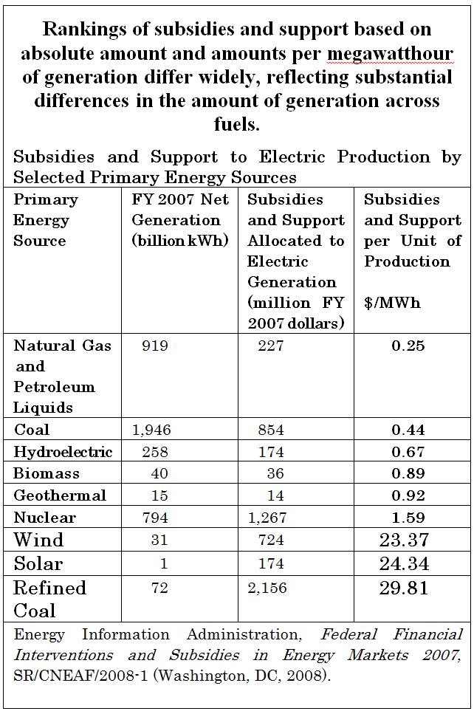
Not including hidden costs

Slide 16
2010 Data from EIA
Beneficiary | Total Subsidy $million | Billion kWh produced | Normalized (¢/kWh) | Compared to Nuclear (Fraction)
Coal | 1,358 | 1847.3 | 0.073 | 0.24
Nuclear | 2,499 | 807.0 | 0.309 | 1.000
Biomass | 1,117 | 34.1 | 3.276 | 10.6
Hydro | 216 | 260.2 | 0.083 | 0.27
Solar | 1,134 | 1.8 | 63. | 204
Wind | 4,986 | 94.7 | 5.26 | 17
Geothermal | 273 | 16.7 | 1.63 | 5.3
(Nat. gas & Petro. Liq.) | 2,690 | 1,024.8 | 0.26 | 0.84

Slide 17
The View from Promoters of Renewable Energy

Slide 18
Marshall Goldberg at Renewable Energy Policy Project (REPP-Crest)
US Subsidies in 1999
Nuclear: $685 million
Wind: $38.4 million
Solar: $92 million

Slide 19
Use Marshall Goldberg’s Figures
US Subsidies in 1999
Nuclear: 0.09 ¢/kWh
Wind: 0.85 ¢/kWh
Solar: 10.8 ¢/kWh

Slide 20
JOBS !!
Give Everybody Picks and Shovels

Slide 21
Job Creation
Jobs are created by cheap energy and destroyed by expensive energy
Ideally, a utility would function perfectly with no employees whatsoever. (Every one of them receives a paycheck, courtesy of the customers.)

Slide 22
SUMMARY
The wind, solar, biofuel, and geothermal industries are not fledgling industries
Renewables have, by far, the highest subsidies per unit of energy produced
Jobs in the energy industry cost jobs in other industries.

